Slide 1
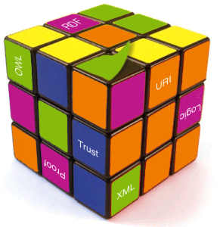
A Semantic Clustering-based Approach For Searching And Browsing Tag Spaces
Date: 2011/10/17
Source:Damir Vandic et. al (SAC’11)
Speaker:Chiang,guang-ting
Advisor: Dr. Koh. Jia-ling

Slide 2
Index
Introduction
Framework design
Implementation
Experiment
Conclusion

Slide 3
Introduction
Today’s Web offers many services that enable users to label content on the Web by means of tags.
Even though tags are a flexible way of categorizing data, they have their limitations.
Tags are prone to typographical errors or syntactic variations due to the amount of freedom users have, e,q, ”waterfal” and “waterfall”.

Slide 4
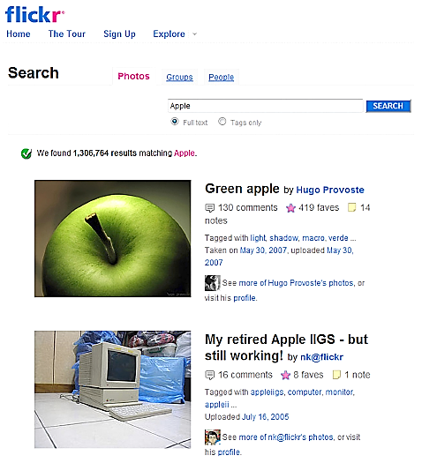

Slide 5
Introduction
Motivation:
Many of the existing cloud tagging systems are unable to cope with the syntactic and semantic tag variations during user search and browse activities.
Goal:
Propose the Semantic Tag Clustering Search, a framework able to cope with these needs.

Slide 7
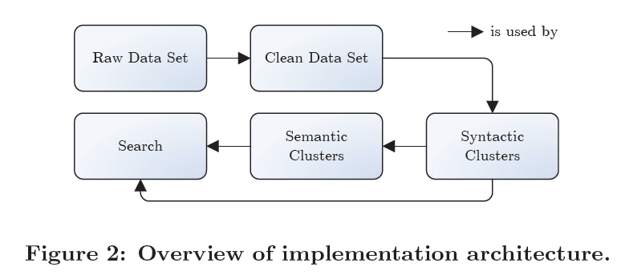
Framework design

Slide 8
Framework design
Clean data set
Syntatic variations
Semantic clustering
Searching tag spaces

Slide 9
Input data
Framework design
t1
t2
t3
Base on Flickr
apple
…..
t4
t5
t6
D={User, Tags, Pic}
…..
Jack123
t1
website
…..
t7
t8
t9
{ Mac, apple, iphone, iPod }

Slide 10
Clean data set
Framework design
Some pictures have many unusable tags due to the freedom of the users in setting picture tags.
Apply a sequence of filters that remove tags with “unrecognizable” signs, tags which are complete sentences.

Slide 11
Syntatic variations
Framework design
Syntatic detection
The algorithm for the syntactic variation clustering uses an undirected graph G = (T,E) as input.
T : contains elements which represent a tag id
E : the set of weighted edges (triples ($t_{i}$, $t_{i}$, $w_{ij}$)representing the
similarities between tags.
The algorithm then proceeds by cutting edges that have a weight lower than a threshold $β$.
$w_{ij}$ is based on the normalized Levenshtein value, combined with the cosine value.

Slide 12
P1 | {apple, fruit, food}
P2 | {apple, apples, fruit, food}
P3 | {apples, fruit}
P4 | {apples, food}
P5 | {apples, food}
P6 | {food}
P7 | {fruit, food}
$vector\left(t1\right)$ = {1, 1, 0, 0, 0, 0, 0}
$$β=0.6$$
$vector\left(t2\right)$ = {0, 1, 1, 1, 1, 0, 0}
$vector\left(t3\right)$ = {1, 1, 1, 0, 0, 0, 1}
$vector\left(t4\right)$ = {1, 1, 0, 1, 1, 1, 1}
$w_{apple,apples}$= ?
1*+083*0.35
=0.83
>$β$ it’s variation
$$\frac{1}{max⁡(5,6)}=\frac{1}{6}$$
$$\frac{max⁡(length(t1),length(t2))}{max⁡( length\left(T\right) )}$$
$$=1$$
$$cos⁡( vector\left(i\right),vector\left( j\right))$$
$\frac{1}{\sqrt{2}∗\sqrt{4}}$=0.35
Base on “ Co-occurance ”

Slide 13
Semantic clustering
Framework design
Initially:
each tags is considered as a cluster.
Subsequently,tags are added to an arbitrary cluster if they are sufficiently similar to that cluster.
Heuristics merge:
The first heuristic merges two clusters if one cluster K contains the other cluster L and is denoted as $K⊆L$.
Checks for small differences between clusters.Whenever clusters differ within a small margin, the distinct words from the smaller cluster are added to the larger cluster, while removing the smaller cluster.
Issue:
The larger clusters should not merge too quickly and the smaller clusters should not merge too slowly

Slide 14
Semantic clustering
Framework design
$vector\left(apple\right)$ = {1, 1, 1, 0, 0, 0, 0}
$vector\left(apples\right)$ = {0, 0, 1, 1, 1, 0, 0}
$vector\left(fruit\right)$ = {1, 0, 1, 1, 1, 0, 1}
Adapted heuristic:
Use the semantic relatedness of the difference between two clusters.
Merge two clusters K and L, where |K|$≥$|L|, when the average
cosine $\overline{cos}$(K,L) is above a certain threshold $δ$.
,
$vector\left(food\right)$ = {0, 1, 0, 1, 1, 1, 1}
 | C1
P1 | {apple, fruit}
P5 | {apples, fruit, food}
$\overline{cos}\left(C1,C2\right)=$($\frac{\frac{cos⁡(apple,apples)}{2}+\frac{cos⁡(fruit,apples)}{2}}{1}$)+($\frac{\frac{cos⁡(apple,food)}{2}+\frac{cos⁡(fruit,food)}{2}}{1}$)
 | C2
P2 | {apples, food}
P4 | {apples,fruit. food}
$$=0.388+0.19=0.578$$

Slide 15
Semantic clustering
Adapted heuristic:
Takes into account the size of the difference between two clusters, combined with a dynamic threshold.
Merge the clusters when the normalized difference $η(K,L)$
between the clusters K and L is smaller than a dynamic
threshold $ε$ .
$$φ=0.8$$
$$η\left(C1,C2\right)=?$$
$$ε=\frac{0.8}{\sqrt{2}}=0.56$$
$$η\left(C1,C2\right)=\frac{1}{2}=0.5$$
$$η\left(C1,C2\right)<ε$$
Merge together!!
 | C1
t1 | {a, b}
t3 | {a, b, c}
 | C2
t2 | {a, b, c, e}
t4 | {a, b, c}

Slide 16
Searching tag spaces
Framework design
The search engine of the proposed STCS framework sorts the pictures based on relevance with the query.
Defining the query q as an m dimensional row vector of tags $q_{i}$, and a picture p as an n-dimensional row vector of tags $p_{j}$ , where q = [$q_{1}$ · · · $q_{m}$] and p = [$q_{1}$ · · · $q_{n}$].

Slide 17
Searching tag spaces
Feature:
Automatic replacement of syntactic variations by their corresponding labels.
The ability to detect contexts. If a tag can have multiple meanings, the search engine asks the user to choose a cluster to indicate the sense that was actually meant.

Slide 18
Implementation
The STCS framework has been implemented in a Javabased Web application i.e., http://XploreFlickr.com.
The application uses a subset from the Flickr database.
Clean data set:
Raw data
Users | 57,009
Pictures | 166,544
tags | 317,657
Cleaned data
Users | 50,986
Pictures | 147,132
tags | 27,401

Slide 19
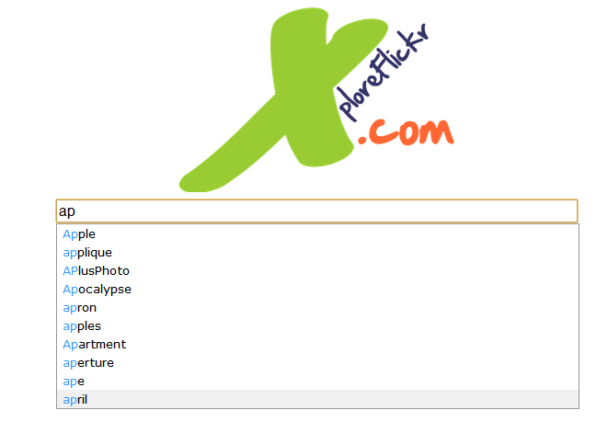
Implementation
Auto-completion

Slide 20
Implementation
Syntatic variation detection

Slide 21
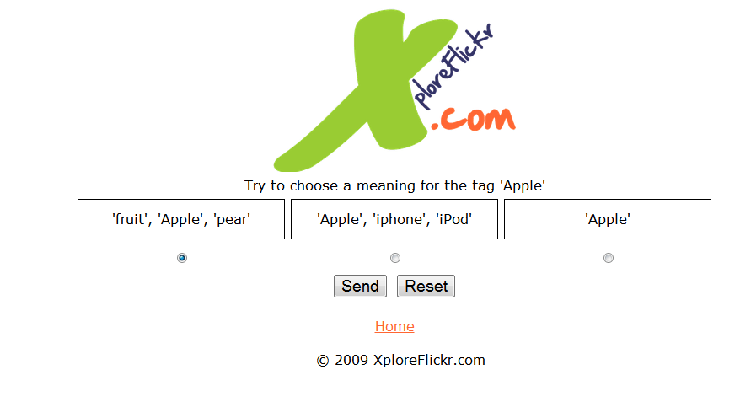
Implementation
Context selection

Slide 22
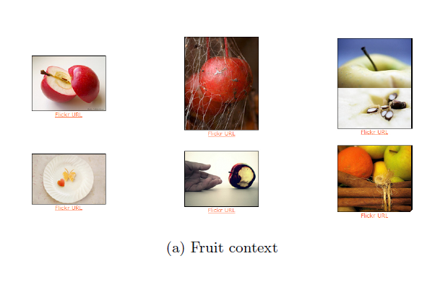
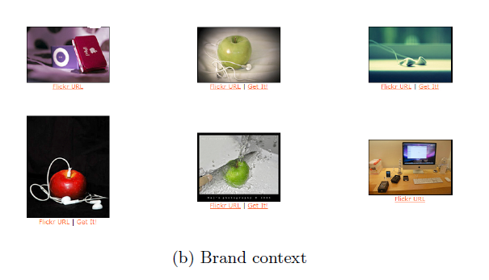
Implementation
Context for different
selection

Slide 23
Experiment
Syntatic variations
Semantic clustering
Searching tag spaces

Slide 24
Syntatic variations
Experiment
Define a test set S that contains 200 randomly chosen tag combinations
Threshold $β$=0.62
Identify 10 mistakes
Resulting in a syntactic error rate of 5%.

Slide 25
Semantic clustering
Experiment
100 randomly chosen clusters.
Our analysis three thresholds.
After generating 100 random clusters, obtain 458 tags.
Misplaced tags: 44 misplaced tags and thus the error rate is 9.6%.
$$χ=0.8$$ | Determines whether or not a tag is added to a cluster during the initial cluster creation.
$$δ=0.7$$ | Defines the minimum average cosine similarity when merging two sets of which the smaller set has elements that the larger set does not contain.
$$ε=0.8$$ | As parameters for the function that defines the dynamic threshold.

Slide 26
Searching tag spaces
Experiment
Compare the cluster-driven search engines”NHC”, “NHC STCS”.
This comparison is based on the precision of the first 24 results of an arbitrary query (p@24).
In this paper finds more contexts than the original approach.
NHC | 214 | 0.86%
NHC STCS | 368 | 0.88%

Slide 27
Conclusion
Proposed the Semantic Tag Clustering Search (STCS) framework for building and utilizing semantic clusters from a social tagging system.
The framework has three core tasks: removing syntactic variations, creating semantic clusters, and utilizing obtained clusters to improve search and exploration of tag spaces.
Proposed a measure based on the normalized Levenshtein value, combined with the cosine value.
With respect to a traditional search engine, searching tag spaces using STCS retrieves more relevant results and achieves a higher precision.

Slide 28
Thx for your listening …..

Slide 29
supplement

Slide 30
Levenshtein distance
又稱Edit distance.其定義是一單字,集合,序列轉換成另一組所需的最少編輯次數。
編輯的操作可分為三種： 取代：將一個字元取代為另外一個字元。 插入：在序列中插入一個字元。
刪除：刪除序列中的一個字元。
Ex:
Levenshtein distance between "kitten" and "sitting" is 3
kitten → sitten (substitution of 's' for 'k')
sitten → sittin (substitution of 'i' for 'e')
sittin → sitting (insertion of 'g' at the end).

Slide 31
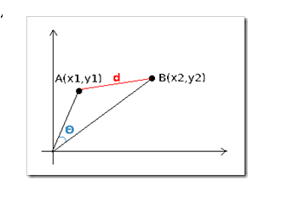
Cosine similarity
If x and y are two document vectors, then
cos( x, y) = $\frac{\text{(}\text{x} \text{•} \text{y}\text{)}}{\text{||}\text{x}\text{|| ||}\text{y}\text{||}}$
Example:
x = 3 2 0 5 0 0 0 2 0 0
y = 1 0 0 0 0 0 0 1 0 2
x • y= 3*1 + 2*0 + 0*0 + 5*0 + 0*0 + 0*0 + 0*0 + 2*1 + 0*0 + 0*2 = 5
||x|| = (3*3+2*2+0*0+5*5+0*0+0*0+0*0+2*2+0*0+0*0)^{0.5} = (42) ^{0.5} = 6.481
||y|| = (1*1+0*0+0*0+0*0+0*0+0*0+0*0+1*1+0*0+2*2) ^{0.5} = (6) ^{0.5} = 2.245
cos( d₁, d₂ ) = .3150

